Slide 1
Mongodb Data Collection

Slide 2
Chosen Websites To Scrape
Which news website?
The Time and HuffPost
Why?
Because they have a similar architecture
Makes it easier to loop

Slide 3
How to scrape?
Find the tag with the article URL
In this case, the a tag in the href
Href is not the full URL => Have to concatenate it with the base URL

Slide 4
What to scrape?
We only want
Title
Author
Date
How?
Find the tags containing each information and turn them to text
Date needs to be formatted to YY-MM-DD

Slide 5
Save the data
Connect to the client localhost
Get to the Articles Database
Get to the collumn you want to save the data in
Use insert_many in the selected collumn

Slide 6
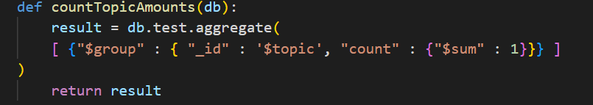
Number of Articles per topic

Slide 7
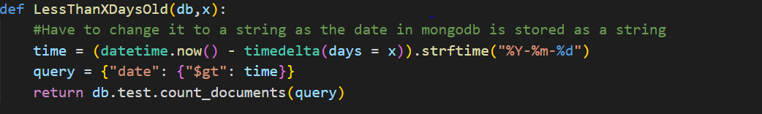
Find all documents less than X days old

Slide 8
Or Query

Slide 9
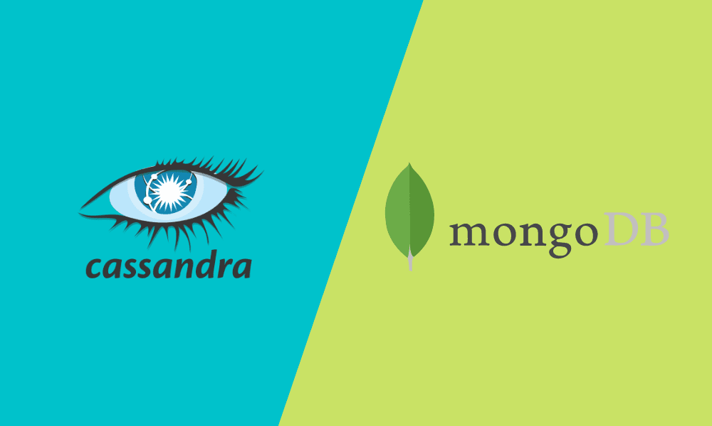

Unveiling NoSQL data base : vs
Katouzian Pouria Marzouk Ouro-Gomma
Manuel Houyon
UNIVERSITY OF LIÈGE 2024

Slide 10

How are these databases classified in terms of their structure? Are they row-oriented or column-oriented?
MongoDB and Cassandra, both being prominent NoSQL databases, are classified based on their structural orientation within the NoSQL paradigm.
MongoDB is primarily classified as a document-oriented or document-based NoSQL database, while Cassandra is categorized as a column-oriented NoSQL database.

Slide 11
Who does use Mongo DB and Cassandra?
MongoDB and Cassandra are used by many different kinds of organizations, from small startups to big companies and even government agencies. They're good for different things MongoDB is flexible and easy to scale, while Cassandra is great for handling lots of data quickly. Some organizations use both to do different jobs.
MongoDB is used in Tech Startups, Enterprises, Government entities and in Educational porpuse and institutions On the other hand, cassandra is used in Internet Companies, IoT (Internet of Things) Industry, Financial Services and Gaming Industry.

Slide 12
Key Differences Between MongoDB and Cassandra: Maintenance, Licensing, and Architecture
Who maintains Cassandra?
Who maintains Mango DB?
Cassandra is maintained by the Apache Software Foundation, an open-source community.
MongoDB is maintained by MongoDB Inc.
License type?
License type?
Cassandra is distributed under the Apache License 2.0, a permissive open-source license
MongoDB adopts the Server Side Public License (SSPL), a copyleft license introduced by MongoDB Inc
Architecture: Peer-to-peer? Master-Slave?
Architecture: Peer-to-peer? Master-Slave?
Cassandra utilizes a decentralized, peer-to-peer architecture, functioning as a distributed hash table (DHT).
MongoDB typically employs a master-slave replication architecture. A primary node receives write operations and replicates data to secondary nodes (replica sets). The primary node handles writes, while secondary nodes serve reads and offer failover support

Slide 13
Yarn
Ressource management layer
Separates two main deamons Ressource Manager and Node Manager
Multiple data processing
Fault tolerance by monitoring tasks

Slide 14
Ressource manager
Yarn’s Master Deamon
Scheduling decisions
Ressource allocation

Slide 15
Node manager
Yarn’s Slave Deamon
Reports
Monitor containers

Slide 16
Big data architecture at uber
Data ingestion
Storage
Processing
Analytics
Scalability and fault Tolearance

